Slide 1
China and Beyond China
Arjun Divecha

Slide 2
From China to Beyond China
China has become less attractive.
Is this cyclical or secular? Yes
Supply chains are moving out of China for multiple reasons.
Who is benefiting from these moves?
How does one take advantage of this secular shift?
An example of a company that’s benefiting.
This is a long game.

Slide 3
China’s Economy Has Not Rebounded from the Pandemic
CHINA CONSUMER CONFIDENCE
As of 7/31/24 | Source: Bureau of Statistics: China

Slide 4
China’s Economy Has Not Rebounded from the Pandemic
CHINA INDUSTRIAL PRODUCTION
Year-over-Year
As of 12/31/23 | Source: Bloomberg

Slide 5
China’s Economy Has Not Rebounded from the Pandemic
CHINA RETAIL SALES
Year-over-Year (%)
As of 8/31/24 | Source: Bureau of Statistics: China

Slide 6
It’s Not Just Cyclical…
HOUSE PRICES FOR 70 CHINESE CITIES
Average Annual Change (%)
As of 8/31/24 | Source: Bureau of Statistics: China

Slide 7
…It’s Reflected in the Stock Market As Well
CHINA A SHARE INDEX LEVEL
Shanghai Composite Index
As of 9/30/24 | Source: Bureau of Statistics: China

Slide 8
It’s Not Just Sentiment, But Reality
CHINA RETURN ON EQUITY
Shanghai Composite Index Best ROE (%)
As of 8/31/24 | Source: Bureau of Statistics: China, Bloomberg

Slide 9
And Markets Are Not Stupid
CHINA FORWARD P/E RATIO
Shanghai P/E Ratio Index
As of 9/30/24 | Source: Bureau of Statistics: China, Bloomberg

Slide 10
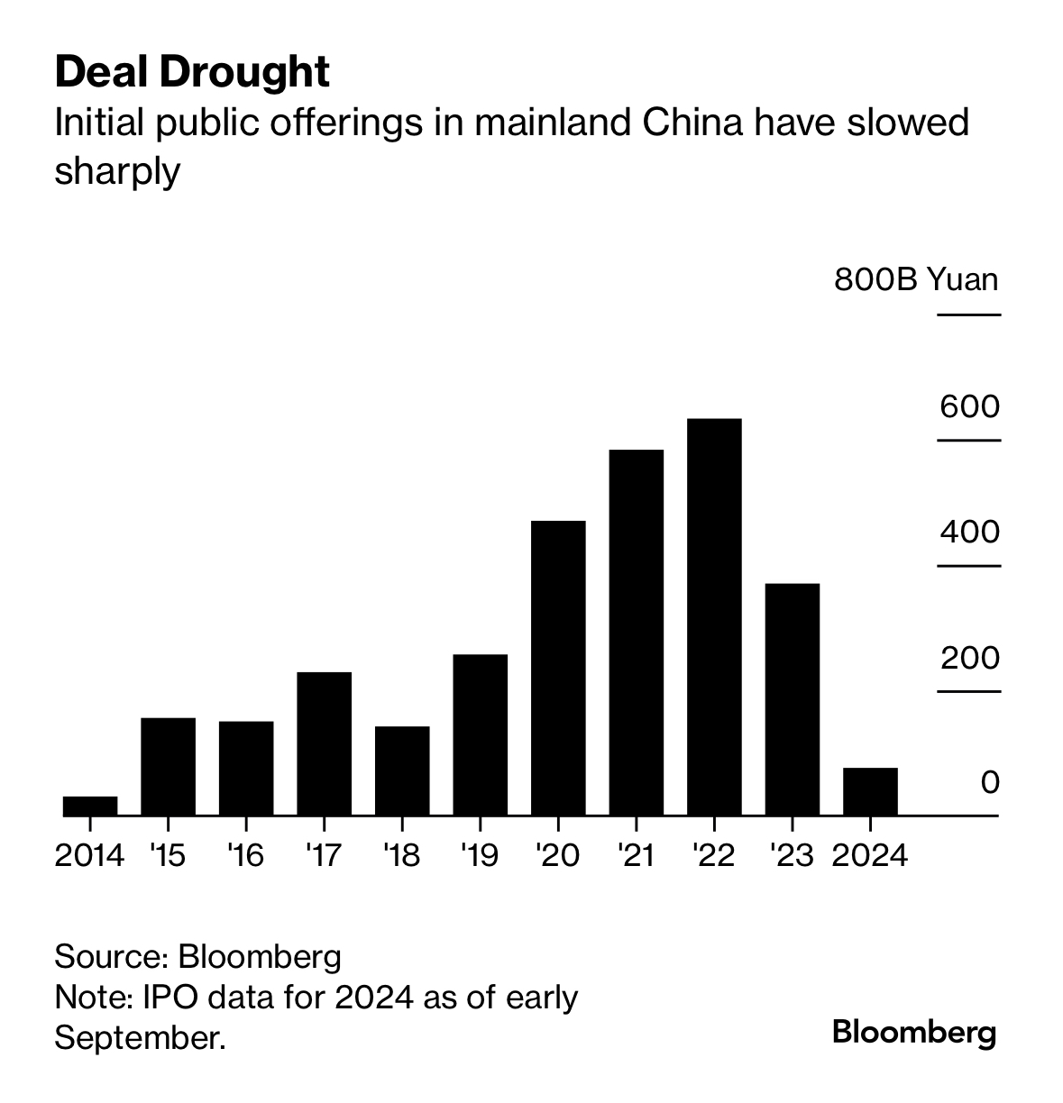
Capital Raising Is At a Standstill
Source: Financial Times, Bloomberg
IPO data for 2024 as of early September.

Slide 11

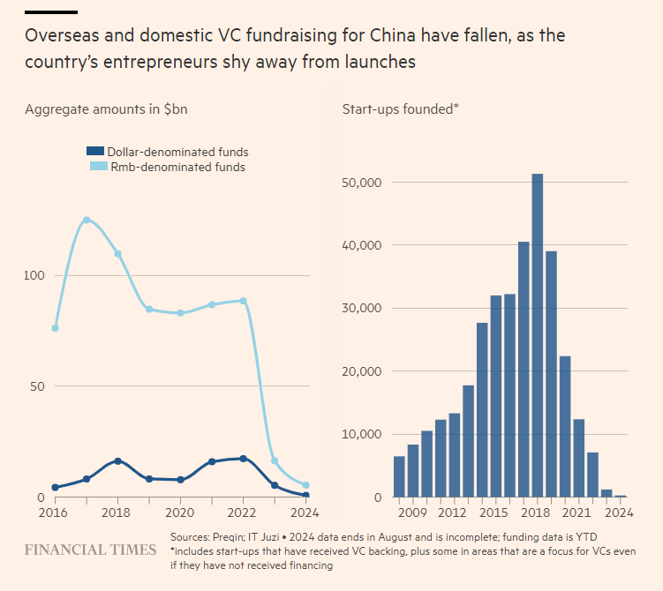
Capital Raising Is At a Standstill
Source: Financial Times, Prequin, IT Juzi
2024 data ends in August and is incomplete; funding data is YTD.

Slide 12
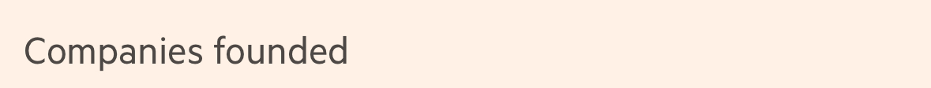
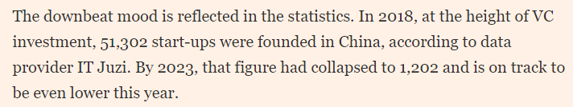
And New Business Formation Has Ground to a Halt
Source: Financial Times, Prequin, IT Juzi
2024 data ends in August and is incomplete; funding data is YTD. Includes start-ups that have received VC backing, plus some in areas that are a focus for VCs even if they have not received funding.

Slide 13
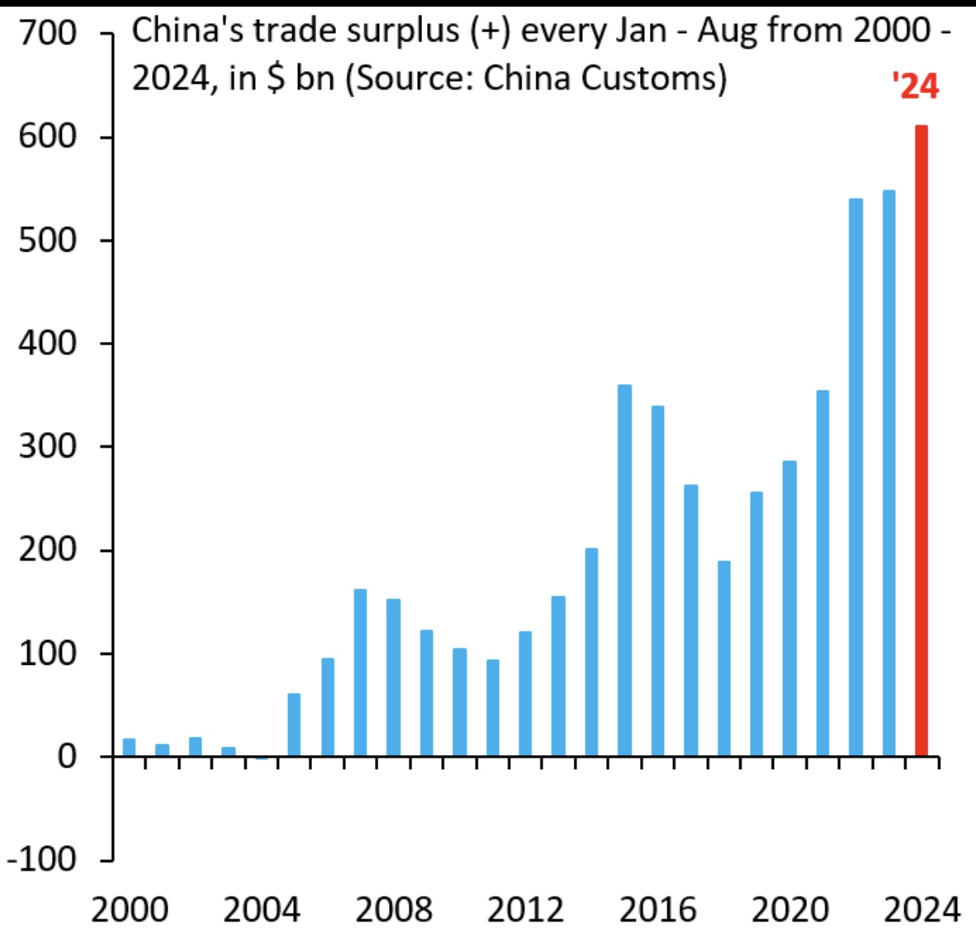
The Lack of Domestic Vigor is being compensated for by booming trade surpluses
CHINA’S TRADE SURPLUS (+) EVERY JANUARY – AUGUST FROM 2000 – 2024
700
‘24
600
500
400
$ Billions
300
200
100
0
2000
2004
2008
2012
2016
2020
2024
Source: China Customs

Slide 14
But Not to the U.S.
MARKET SHARE OF U.S. IMPORTS
% of Total
China
Source: https://www.census.gov/foreign-trade/balance/c5700.html

Slide 15
What’s the Story Behind the Malaise?
Let’s look at why China succeeded from 1978 – 2014, and what's changed now?
Demographics From labor surplus and household formation to an aging population
Capitalism: From Deng to Xi - The Empire Strikes Back
Access to global markets: Have alienated their main customers and suppliers of capital.
Competence: Economic decision-making has shifted from the collective wisdom of the Mandarins to Xi.

Slide 16
Due to Covid, Taiwan, Trade Tensions, etc., The U.S. is pivoting away from trade with China
 | China | Mexico | Vietnam | India | Korea | Taiwan | Thailand | Europe
China Peak, 2018 | 21.59 | 13.24 | 1.98 | 2.07 | 2.95 | 1.80 | 1.31 | 18.63
March 2024 | 11.46 | 15.91 | 3.81 | 2.90 | 4.44 | 4.97 | 2.01 | 20.89
Percent of Peak | 53% | 120% | 192% | 140% | 151% | 276% | 153% | 112%
 | –
As of 8/31/23 | Source: Federal Reserve Bank, GMO

Slide 17
So, Does This Mean Onshoring is Booming? Umm…
U.S. TRADE BALANCE
% of GDP
As of 4/30/24 | Source: U.S. Federal Reserve

Slide 18
But The IRA and Chips Act are starting to impact investment in the U.S.
U.S. REAL ESTATE FIXED INVESTMENT IN MANUFACTURING STRUCTURES
Billions of Chained 2017 Dollars
As of 4/30/24 | Source: U.S. Federal Reserve
Data is quarterly, seasonally adjusted annual rate.

Slide 19
And Global Corporates and Governments are looking to diversify away from China
MENTIONS DURING U.S. CORPORATE PRESENTATIONS OF RE-/NEAR/ON-SHORING
Source: BofA Global Research, AlphaSense

Slide 20

So Who’s Benefiting From this Move?
And how do we capture this opportunity?
Impact on Economy
Export Structure in Place
Labor and Demographics
Institutional Capacity

Slide 21
TAIWAN TECH IS SHIFTING AWAY FROM China
TAIWAN APPROVED OUTWARD INVESTMENTS TO MAINLAND CHINA AND ASEAN
CHINA/HONG KONG AS PERCENTAGE OF TAIWAN’S TOTAL EXPORTS
16
45
14
43
41
12
39
10
37
8
35
$USD Billions
% Annualized
33
6
31
4
29
27
2
25
0
23
1991
1999
2007
2014
8M24
2000
2005
2011
2017
2024
Investment to Mainland China
Investment to ASEAN
As of 9/30/24 | Source: Jefferies, Department of Investment Review, Ministry of Economic Affairs, CEIC

Slide 22
So, Who’s Benefiting From this Move?
INDIA TOTAL CAPEX OF NSE 500 COMPANIES
Millions of $USD
Source: Capitaline

Slide 23
We’ve Only Just Begun…
INDIA ELECTRONICS AND ELECTRICALS
Indian companies have doubled their sales in the past four years.
Apple will produce 25% of their iPhones in India by 2025.
India government support – it is expected the semiconductor business will be worth $63 billion by 2026.
$USD Billions
But:
For India to take 10% of China’s market share in Electronics, the industry would have to expand 600%
As of 8/31/24 | Source: Company reported

Slide 24
But Not to the U.S.
MARKET SHARE OF U.S. IMPORTS
Mexico
% of Total
China
Source: https://www.census.gov/foreign-trade/balance/c5700.html

Slide 25
GMO Beyond China investment strategy
Pick the countries that benefit the most from this move.
Pick the sectors that reflect the themes that are most exposed.
Pick high quality companies within these sectors that benefit, at reasonable valuations (QARP?)
Opportunity sensitive, not benchmark sensitive

Slide 26
Most and least attractive countries
Who benefits from a China manufacturing exodus?
Export Structure in Place
Impact on Economy
Labor & Demographics
Domestic Market Size
Institutional Capacity
Companies Relocating
+
+
+
+
+
Kuwait
Chile
Saudi Arabia
Thailand
Vietnam
Qatar
Colombia
Indonesia
India
Mexico

Slide 27
Themes that benefit from this move
Theme
Higher Economic Growth Due To Nearshoring
Banks
Retailing
Market Share Gain from Chinese Competitors
Tech Hardware
Apparel
Chemical
Consumer Electronics
EV Battery
Construction Materials
Engineering and Construction
Auto Components
Real Estate and Infrastructure
Theme
Rise in Industrial Activity
Port and Logistics
Airport
Energy and Power Distributors
Increase in Global Capital Expenditure
Industrial Machinery
Tech H/W Supply Chain
High-end Semiconductor Equipment
Air Conditioning
Shift in Global EV & Renewables Supply Chain
As of 3/31/23 | Source: GMO
Model portfolio characteristics have many inherent limitations and may not reflect the impact that material economic and market factors may have on the decision-making process if client fund were actually managed in the manner shown. Actual characteristics may differ substantially from the model characteristics presented.

Slide 28
Themes map onto sector opportunities
Model exposures by country sectors
 | Consumer Discretionary | Consumer Staples | Energy | Financials | Industrials | IT | Materials | Real Estate
Brazil
Chile
Czech
India
Indonesia
Korea
Mexico
Poland
Taiwan
Thailand
Turkey
Vietnam
MNC
As of 3/31/23 | Source: GMO

Slide 29

Mexico Real Estate Example: Vesta
Vesta is a fully integrated real estate owner, operator, and developer. It has one of the largest and most modern industrial portfolios in Mexico.

Slide 30
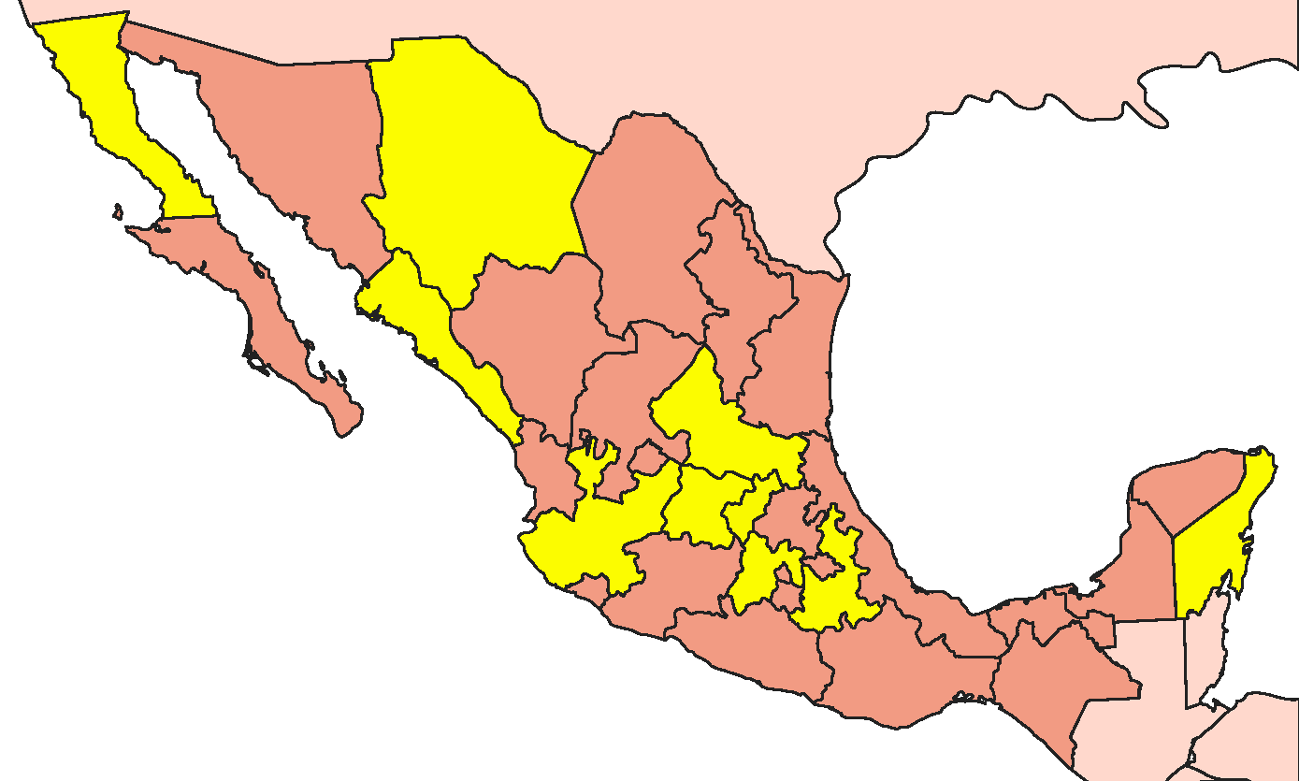
Mexico Real Estate Example: Vesta
Selected distribution of Vesta’s industrial properties
Tijuana
Ciudad Juarez
San Luis Potosi
Querétaro
Los Mochis
Tlaxcala
Cancún
Lagos de Moreno
Guanajuato
Toluca
Source: vesta.com.mx
Puebla

Slide 31
Mexico Real Estate Example: Vesta
PRICE ($USD)
As of 8/31/24 | Source: Bloomberg

Slide 32
Mexico Real Estate Example: Vesta
PRICE-TO-NET ASSET VALUE PER SHARE
As of 8/31/24 | Source: Bloomberg

Slide 33
The “Beyond China” Universe is not expensive
P/E MULTIPLES HAVE NOT CHANGED
As of 8/31/24 | Source: MSCI, GMO
Data is 3-months rolling. MSCI data may not be reproduced or used for any other purpose. MSCI provides no warranties, has not prepared or approved this report, and has no liability hereunder. Please visit https://www.gmo.com/americas/benchmark-disclaimers/to review the complete benchmark disclaimer notice.

Slide 34
The “Beyond China” Universe is not expensive
PRICE-TO-BOOK MULTIPLES
As of 8/31/24 | Source: MSCI, GMO
MSCI data may not be reproduced or used for any other purpose. MSCI provides no warranties, has not prepared or approved this report, and has no liability hereunder. Please visit https://www.gmo.com/americas/benchmark-disclaimers/to review the complete benchmark disclaimer notice.

Slide 35

The Beyond China journey is in its early stages
We’ve only just begun…
10% of China’s industry exports scale to peers’ current exports
AUTOMOTIVE
HIGH TECH ELECTRONICS & ELECTRICAL
TEXTILES & APPAREL
CHEMICALS
As of 5/31/23 | Source: UNCTAD, GMO

Slide 36
Beyond China Strategy
Portfolio characteristics
CHARACTERISTICS
COUNTRY WEIGHTS (%)
SECTOR WEIGHTS (%)
As of 8/30/24 | Source: GICS Sector Report, GMO
Model portfolio characteristics have many inherent limitations and may not reflect the impact that material economic and market factors may have on the decision-making process if client fund were actually managed in the manner shown. Actual characteristics may differ substantially from the model characteristics presented. MSCI data may not be reproduced or used for any other purpose. MSCI provides no warranties, has not prepared or approved this report, and has no liability hereunder. Please visit https://www.gmo.com/americas/benchmark-disclaimers/to review the complete benchmark disclaimer notice.

Slide 37
From China to Beyond China
China has become less attractive, both cyclically and secularly
Supply chains are moving out of China.
Emerging Markets are the main beneficiaries.
India, Vietnam, Mexico…
Infrastructure, Industrials, Tech…
This is not your fathers EM strategy…
This is a long game.
We’ve only just begun…

Slide 38

Q &A

Slide 39


Slide 40
Important information: Simulated Model Performance
Limitations of Simulated Model Performance. The performance presented reflects simulated model performance an investor may have obtained had it invested in the manner shown and does not represent performance that any investor actually attained. The simulated model performance presented is based upon the investment methodology discussed herein. No representation or warranty is made as to the reasonableness of the methodology used or that all methodologies used in achieving the returns have been stated or fully considered. Simulated model returns have many inherent limitations and may not reflect the impact that material economic and market factors may have had on the decision-making process if client funds were actually managed in the manner shown. Actual performance may differ substantially from the simulated model performance presented. Changes in the methodology may have a material impact on the simulated model returns presented. There can be no assurance that GMO will achieve profits or avoid incurring substantial loss.
The simulated model performance is adjusted to reflect the reinvestment of dividends, other income and is net of estimated transaction cost and borrowing costs. Simulated model returns are being shown net of a model management or incentive fees. Actual fees may vary depending on, among other things, the applicable fee schedule and portfolio size. GMO’s fees are available upon request and also may be found in Part 2 of its ADV. Past performance is no guarantee of future results.

Slide 41
Important information
This presentation has been provided to you by Grantham, Mayo, Van Otterloo & Co. LLC (“GMO”) for illustrative purposes only, is intended exclusively for the use of the person to whom it has been delivered by GMO, and is not to be reproduced or redistributed to any other person. Nothing contained herein constitutes investment, legal, tax, regulatory, accounting or other advice of any kind nor is it to be relied on in making an investment or other decision. This presentation should not be viewed as a current or past recommendation or a solicitation of an offer to buy or sell any securities or to adopt any investment strategy. The investment strategy and themes discussed herein may be unsuitable for investors depending on their specific investment objectives and financial situation.
The information in this presentation is only as current as the date indicated, and may be superseded by subsequent market events or for other reasons. The information in this presentation has been developed internally and/or obtained from sources believed to be reliable; however, GMO does not guarantee the accuracy, adequacy or completeness of such information. The information contained herein may be based on (i) data that may no longer be current, (ii) estimates that may involve highly subjective assessments and (iii) models that may change from time to time and be different from the assumptions and models used by other persons. Such information should not be the basis for determining the value of any security or financial instrument or in making any decision to buy, sell or hold a security or financial instrument. It should not be assumed that GMO will make investment recommendations in the future that are consistent with the views expressed herein, or use any or all of the techniques or methods of analysis described herein in managing client accounts.
There can be no assurance that an investment strategy will be successful. Historic market trends are not reliable indicators of actual future market behavior or future performance of any particular investment which may differ materially, and should not be relied upon as such. Predictions, opinions, and other information contained in this presentation are subject to change continually and without notice of any kind and may no longer be true after the date indicated. [Forward-looking statements are subject to numerous assumptions, risks and uncertainties, which change over time, and GMO assumes no duty to and does not undertake to update forward-looking statements. Any forward-looking statements are not guarantees of any future performance and actual results or developments may differ materially.
The offer to invest in any financial product issued or advised by GMO is contained in the relevant Information Memorandum, Product Disclosure Statement or other offering document and is subject to the conditions set out therein. Offering documents are available from GMO and should be considered before making any investment decisions.
GMO Australia Limited ABN 30 071 502 639, AFSL 236 656

Slide 42

Boston
53 State Street | Boston, Massachusetts 02109 | Tel: +1 617 330 7500
San Francisco
2150 Shattuck Avenue | Suite 900 | Berkeley, California 94704 | Tel: +1 510 649 6030
Europe
Asia-Pacific
GMO UK Limited
No.1 London Bridge, London SE1 9BG
Tel: +44 20 7814 7600 Fax: +44 20 7814 7605
Company Number: 04658801
GMO UK Limited Authorised and Regulated by the Financial Conduct Authority Registered no 4658801 England.
GMO Netherlands B.V. is licensed by the Netherlands Authority for the Financial Markets
GMO Netherlands B.V.
Gustav Mahlerplein 109 – 115, 26th floor | 1082 MS Amsterdam | Tel: +31 (0)20 7085789
GMO Netherlands B.V. is licensed by the Netherlands Authority for the Financial Markets
GMO Australia Limited
P.O. Box R1817, Royal Exchange, NSW 1225 | Suite 43.02, Grosvenor Place, 225 George Street, Sydney NSW 2000
Tel: +61 2 8274 9900 Fax: +61 2 8003 8800
GMO Australia Limited ABN: 30 071 502 639, ASFL No: 236 656
GMO Singapore Pte. Limited
6 Battery Road, #34-01 | Singapore 049909 | Tel: +65 6532.0346
GMO Singapore Pte. Limited UEN No: 20-0301509-R, Capital Markets Services License No: CMS100016
Tokyo (Representative Office)
2-11-1 Nagatacho Chiyoda-ku | Tokyo, Japan 100-6162

